Slide 1
Speech Technology Processing Application
Over view on Speech Synthesis
Over view on ASR
Accent Conversion

Slide 2
Speech Synthesis

Slide 3
Text to Speech
“Text-to-Speech software is used to convert words from a computer document (e.g. word processor document, web page) into audible speech spoken through the computer speaker”

Slide 4
Text to Speech Synthesis System
Text Normalization
Conversion of Text that include non standard word
    Abbreviation (like )
    Numbers (like)
Text processing
Grapheme to Phoneme (Pronunciation)
Prosody
    Syllabification
    Phrase/clause marking
    Prosody and Intonation
Synthesis

Slide 5
Numbers
Deciding how to convert numbers is another problem TTS systems have to address.
It is a fairly simple programming challenge to convert a number into words, like 1325 becoming "one thousand three hundred twenty-five".
However, numbers occur in many different contexts in texts, and 1325 should probably be read as "thirteen twenty-five" when part of an address (1325 Main St.) and as "one three two five" if it is the last four digits of a social security number.
Often a TTS system can infer how to expand a number based on surrounding words, numbers, and punctuation, and sometimes the systems provide a way to specify the type of context if it is ambiguous.

Slide 6
Abbreviations
Similarly, abbreviations like "etc." are easily rendered as "et cetera", but often abbreviations can be ambiguous.
For example, the abbreviation "in." in the following example: "Yesterday it rained 3 in. Take 1 out, then put 3 in."
"St." can also be ambiguous: "St. John St."
TTS systems with intelligent front ends can make educated guesses about how to deal with ambiguous abbreviations, while others do the same thing in all cases, resulting in nonsensical but sometimes comical outputs: "Yesterday it rained three in." or "Take one out, then put three inches."

Slide 7
Text-to-phoneme challenges
Speech synthesis systems use two basic approaches to determine the pronunciation of a word based on its spelling, a process which is often called text-to-phoneme or grapheme-to-phoneme conversion, as phoneme is the term used by linguists to describe distinctive sounds in a language.

Slide 8
Dictionary Based approach
The simplest approach to text-to-phoneme conversion is the dictionary-based approach, where a large dictionary containing all the words of a language and their correct pronunciation is stored by the program. Determining the correct pronunciation of each word is a matter of looking up each word in the dictionary and replacing the spelling with the pronunciation specified in the dictionary.
Pronunciations lexicon format of W3C (PLS)

Slide 9
What is Pronunciation Lexicon?
Representation of Pronunciation information of the Lexical items along with its Grapheme Representation
Why Pronunciation Lexicon ?
It is required for the development of Speech technology such as Text to Speech Synthesis and Automatic Speech Recognition

Slide 10
What is PLS of W3C?
The Pronunciation Lexicon Specification (PLS) is designed to enable interoperable specification of pronunciation information for both ASR and TTS engines within voice browsing applications
How it is used in TTS and ASR?
The PLS is the standard format of the documents referenced by the <lexicon> element of SSML. The PLS engine will load the external PLS document and transparently apply the pronunciations during the processing of the SSML document. An application may contain several distinct PLS documents to be used in different points of the application.
If a pronunciation lexicon is referenced by a SRGS grammar it can allow multiple pronunciations of the word in the grammar to accommodate different speaking styles

Slide 11
Present Pronunciation Lexicon Markup Language Definition
Elements | Attributes | Description
<lexicon> | version xml:base xmlns xml:lang alphabet | root element for PLS
<meta> | name http-equiv content | meta data container element
<metadata> |  | meta data container element
<lexeme> | xml:id | the container element for a single lexical entry
<grapheme> | orthography | contains orthographic information for a lexeme
<phoneme> | prefer alphabet | contains pronunciation information for a lexeme
<alias> | prefer | contains acronym expansions and words' substitutions
<example> |  | contains an example of the usage for a lexeme

Slide 12
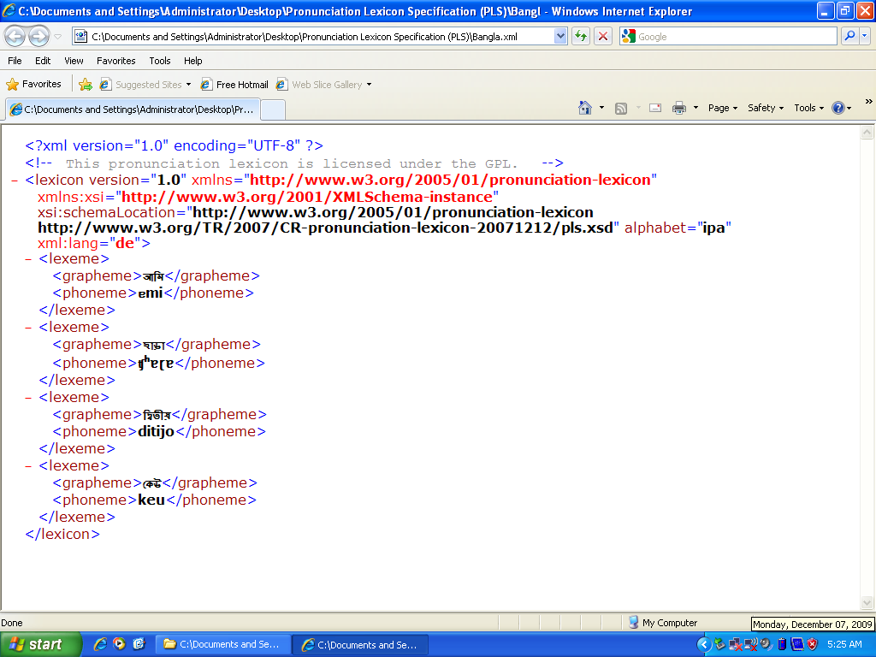

Slide 13
Multiple pronunciations for the Same Orthography
Problem no.1→ Homographs
Homographs are words with the Same Orthography and Different Meanings and Different Pronunciations.
Solution under the existing PLS specification
    Using “Role” attribute under the Lexeme element
    Using “Prefer” attribute under the Phoneme element
This solution is erroneous

Slide 14
Proposed Solution
Proposal -I: (POS as an attribute)
The "pos" (parts of speech) can be an optional attribute under the phoneme element which indicates the proper pronunciation
Advantage:
Reduction of Lexeme numbers.
Removal of Disambiguity

Slide 15
Example
<?xml version="1.0" encoding="UTF-8"?>
<lexicon version="1.0" xmlns="http://www.w3.org/2005/01/pronunciation-lexicon"
alphabet="ipa" xml:lang="bn">
<lexeme>
<grapheme>সরল</grapheme>
<phoneme pos= “adjective”> ʃɔrol </phoneme>
<!-- IPA string is: " ʃɔrol " -->
<!—Itrans is: "sarala" -->
<!—Meaning is : "easy" -- >
<phoneme pos= “verb” > ʃorlo </phoneme>
<!-- IPA string is: " ʃorlo" -->
<!—Itrans is: "sarala" -->
<!—Meaning is: “moved” -- >
<phoneme pos= “null”> ʃɔrol </phoneme>
<!-- IPA string is: " ʃɔrol " -->
<!—Itrans is: "sarala" -->
<!—Meaning is: “ easy” -- >
</lexeme>
</lexicon>

Slide 16
Proposed Solution
Proposal -II: (Pos as an element)
The <lexeme> element may contain optionally one or more <pos> element. Each <pos> element contains the pronunciation of the word depending on pos element information.
Advantage:
Reduction of Lexeme numbers.
Removal of Disambiguity

Slide 17
Example
<?xml version="1.0" encoding="UTF-8"?>
<lexicon version="1.0" xmlns="http://www.w3.org/2005/01/pronunciation-lexicon"
alphabet="ipa" xml:lang="bn">
<lexeme>
<grapheme>সরল</grapheme>
<pos> adjective </pos>
<phoneme> ʃɔrol </phoneme>
<!-- IPA string is: " ʃɔrol " -->
<!—Itrans is: "sarala" -->
<!—Meaning is : "easy" -- >
<pos> verb </pos>
<phoneme> ʃorlo </phoneme>
<!-- IPA string is: " ʃorlo" -->
<!—Itrans is: "sarala" -->
<!—Meaning is: “moved” -- >
<pos> null </pos>
<phoneme> ʃɔrol </phoneme>
<!-- IPA string is: " ʃɔrol " -->
<!—Itrans is: "sarala" -->
<!—Meaning is: “easy” -- >
</lexeme>
</lexicon>

Slide 18
Problem no. 2 :
Ideolectic variation of the same orthographic information
Proposed Solution
<?xml version="1.0" encoding="UTF-8"?>
<lexicon version="1.0" xmlns=http://www.w3.org/2005/01/pronunciation-lexicon alphabet="ipa" xml:lang="bn">
<lexeme>
<grapheme>ঊনত্রিশ</grapheme>
<phoneme prefer="true">untriʃ</phoneme>
<!-- IPA string is: "untriʃ" -->
<phoneme>unotiriʃ</phoneme>
<!-- IPA string is: "unotiriʃ" -->
</lexeme>
</lexicon>

Slide 19
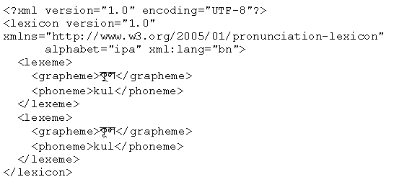
Multiple orthographic representation with same pronunciation
Homophones
Homophones are words with Different Spellings and Different Meanings but the Same Pronunciation

Slide 20
Need of Morphological Information
In some of the languages like Bengali, English not only POS information but also Morphological information especially in case of verb finiteness and honorificity information are very crucial in determining the pronunciation of a homograph.
For Example:
Bengali Verb “kare” has two pronunciations depending on its finiteness
Similarly Bengali verb “dhara” has two pronunciation depending upon its honorificity
English verb “read” has two pronunciations depending on its tense information
POS.s1.s2.s3.s4.s5.s6.s7.s8

Slide 21
Example
<?xml version="1.0" encoding="UTF-8"?>
<lexicon version="1.0" xmlns="http://www.w3.org/2005/01/pronunciation-lexicon"
alphabet="ipa" xml:lang="bn">
<lexeme>
<grapheme>করে</grapheme>
<phoneme: pos= “VM.s1.s2.s3.s4.fin.s6.s7.s8 ” >kɔre</phoneme>
<!-- IPA string is: "kɔre" -->
<!—Itrans is: “kare” -->
<!—Meaning is: “do/does” -- >
<phoneme: pos= “VM.s1.s2.s3.s4.nfin.s6.s7.s8” >kore</phoneme>
<!-- IPA string is: "kore" -->
<!—Itrans is: “kare” -->
<!—Meaning is: “having done” -- >
</lexeme>
</lexicon>
POS→ Part of Speech Marker; s1→ person marker; s2→ tense marker; s3→ aspect marker; s4→ mood marker; s5→ finite/nonfinite; s6→ emphatic/non emphatic; s7→ negative/ non negative; s8→ honorific/ non honorific

Slide 22
Rule based approach
The other approach used for text-to-phoneme conversion is the rule-based approach, where rules for the pronunciations of words are applied to words to work out their pronunciations based on their spellings. This is similar to the "sounding out" approach to learning reading.
Hybrid approach

Slide 23
Speech Synthesis
Articulatory
Parametric
    Formant Synthesis
    HMM based TTS(HTS)
Concatenative
    Di-Phone Synthesis
    Element Based (ESNOLA)
    Unit selection
    Unit Selection with Prosodic Modification
    HMM based speech synthesis

Slide 24
Articulatory synthesis
In an articulatory synthesis, models of the human articulators (tong, lips, teethes, jaw) and vocal ligament are used to simulate how an airflow passes through, to calculate what the resulting sound will be like. It is a great challenge to find good mathematical models and therefore the development of articulatory synthesis is still in research. The technique is very computation-intensive but memory requirements is almost nothing.

Slide 25
Formant Synthesis
This synthesis is a sort of source-filter-method that is based on mathematic models of the human speech organ. The approach pipe is modelled from a number of resonances with resemblance to the formants (frequency bands with high energy in voices) in natural speech.
The first electronic voices Voder, and later on OVE and PAT, were speaking with totally synthetic and electronic produced sounds using formant synthesis. As with articulatory synthesis, the memory consumption is small but CPU usage is large.

Slide 26
Formant Synthesis
Formant synthesis does not use any human speech samples at runtime. Instead, the output synthesized speech is created using an acoustic model.
Parameters such as frequency amplitude etc are varied over time to create a waveform of artificial speech.

Slide 27
Concatenating synthesis
A concatenating synthesis is made of recorded pieces of speech (sound-clips) that is then unitized and formed to speech.
Depending on the length of sound-clips that are used it become a diphone or a polyphonic synthesis.
More developed version is also called a Unit Selection synthesis, where the synthesizer has access to both long and short segments of speech and the best segments for the actual context is chosen

Slide 28
Diphone TTS architecture
Training:
  Choose units (kinds of diphones)
  Record 1 speaker saying 1 example of each diphone
  Mark the boundaries of each diphones,
    cut each diphone out and create a diphone database
Synthesizing an utterance,
  grab relevant sequence of diphones from database
  Concatenate the diphones, doing slight signal processing at boundaries
  use signal processing to change the prosody (F0, energy, duration) of selected sequence of diphones

Slide 29
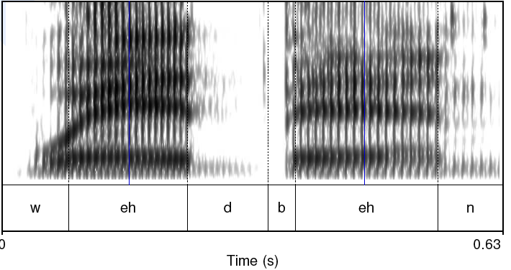
Diphones
Mid-phone is more stable than edge:

Slide 30
Designing a diphone inventory:
Nonsense words
Build set of carrier words:
  pau t aa b aa b aa pau
  pau t aa m aa m aa pau
  pau t aa m iy m aa pau
  pau t aa m iy m aa pau
  pau t aa m ih m aa pau
Advantages:
  Easy to get all diphones
  Likely to be pronounced consistently
    No lexical interference
Disadvantages:
  (possibly) bigger database
  Speaker becomes bored

Slide 31
Designing a diphone inventory:
Natural words
Greedily select sentences/words:
  Quebecois arguments
  Brouhaha abstractions
  Arkansas arranging
Advantages:
  Will be pronounced naturally
  Easier for speaker to pronounce
  Smaller database? (505 pairs vs. 1345 words)
Disadvantages:
  May not be pronounced correctly

Slide 32
Making recordings consistent:
Diiphone should come from mid-word
  Help ensure full articulation
Performed consistently
  Constant pitch (monotone), power, duration
Use (synthesized) prompts:
  Helps avoid pronunciation problems
  Keeps speaker consistent
  Used for alignment in labeling

Slide 33
Architecture of the ESNOLA System
Unicode Text
Text Analyzer
Temp
File
Phone Syll+Ty Word TyC/P
Prosodic
Rule
Table
Prosodic Analyzer
Signal
Dic.
Temp
File
Phone Syll+Ty Word TyC/P Amp Dura Pitch
Synthesis Engine
Resources
Adequate Intonated Synthesized speech

Slide 34
Token generation
1. CVCV. C +CV+V+VC+C+V+V_{o}
बाजे /baaje/
b+baa +aa+aaj+j+je+e+e_{o}
2. VCV. V_{i}+V +VC+C+CV+V+V_{o}
आगे /aage/
aa_{i}+aa+aag+g+ge+e+e_{o}
3. CVYV. C +CV+V+VY+YV+V_{o}
रोयो /royo/
r+ro+o+oy+y+yo+o+o_{o}
भजन् /bhajon/
bha
a
aj
jo
o
on
bh
j
n

Slide 35
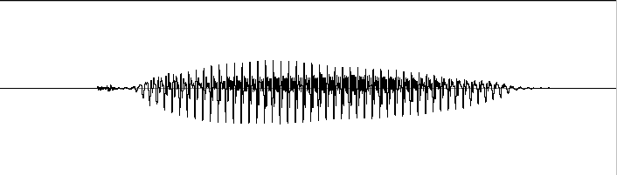
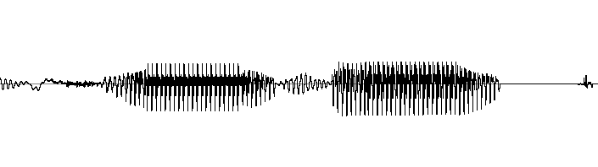
ESNOLA Method Based Speech Synthesis
System for Bangla
Concatenative synthesis is based on putting together pieces ( acoustic unit) of natural(recorded) speech to synthesized an arbitrary utterance
C
CV
V
VC
C
C
CV
V
VC
C
bh
bhaa
aa
aar
r
ra
a
at
t
/bhaarat/
* Epoch Synchronous Non-OverLapping Add

Slide 37
Unit Selection Synthesis
Generalization of the diphone intuition
  Larger units
    From diphones to sentences
  Many copies of each unit
    10 hours of speech instead of 1500 diphones (a few minutes of speech)
  No signal processing applied to each unit
    Unlike diphones

Slide 38
Why Unit Selection Synthesis
Natural data solves problems with diphones
  Diphone databases are carefully designed but:
    Speaker makes errors
    Speaker doesn’t speak intended dialect
    Require database design to be right
  If it’s automatic
    Labeled with what the speaker actually said
    Coarticulation, schwas, flaps are natural
“There’s no data like more data”
  Lots of copies of each unit mean you can choose just the right one for the context
  Larger units mean you can capture wider effects

Slide 39
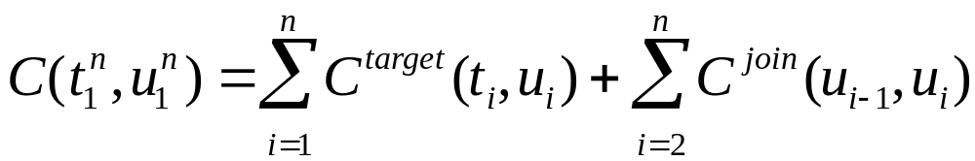
Unit Selection Intuition
Given a big database
For each segment (diphone) that we want to synthesize
  Find the unit in the database that is the best to synthesize this target segment
What does “best” mean?
  “Target cost”: Closest match to the target description, in terms of
    Phonetic context
    F0, stress, phrase position
  “Join cost”: Best join with neighboring units
    Matching formants + other spectral characteristics
    Matching energy
    Matching F0

Slide 40
Targets and Target Costs
A measure of how well a particular unit in the database matches the internal representation produced by the prior stages
Features, costs, and weights
Examples:
  /ih-t/ from stressed syllable, phrase internal, high F0, content word
  /n-t/ from unstressed syllable, phrase final, low F0, content word
  /dh-ax/ from unstressed syllable, phrase initial, high F0, from function word “the”

Slide 41
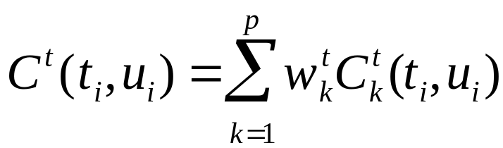
Target Costs
Comprised of k subcosts
  Stress
  Phrase position
  F0
  Phone duration
  Lexical identity
Target cost for a unit:

Slide 42
How to set target cost weights (1)
What you REALLY want as a target cost is the perceivable acoustic difference between two units
But we can’t use this, since the target is NOT ACOUSTIC yet, we haven’t synthesized it!
We have to use features that we get from the TTS upper levels (phones, prosody)
But we DO have lots of acoustic units in the database.
We could use the acoustic distance between these to help set the WEIGHTS on the acoustic features.

Slide 43
How to set target cost weights (2)
Clever Hunt and Black (1996) idea:
Hold out some utterances from the database
Now synthesize one of these utterances
  Compute all the phonetic, prosodic, duration features
  Now for a given unit in the output
  For each possible unit that we COULD have used in its place
  We can compute its acoustic distance from the TRUE ACTUAL HUMAN utterance.
  This acoustic distance can tell us how to weight the phonetic/prosodic/duration features

Slide 44
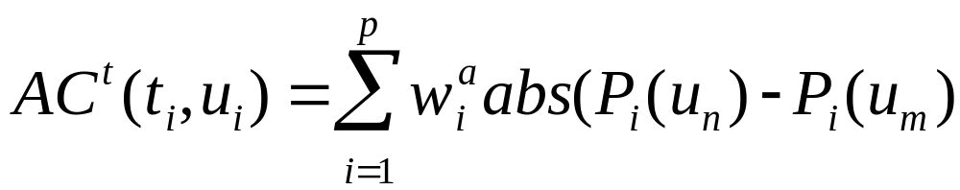
How to set target cost weights (3)
Hunt and Black (1996)
Database and target units labeled with:
  phone context, prosodic context, etc.
Need an acoustic similarity between units too
Acoustic similarity based on perceptual features
  MFCC (spectral features)
  F0 (normalized)
  Duration penalty

Slide 45
How to set target cost weights (3)
Collect phones in classes of acceptable size
  E.g., stops, nasals, vowel classes, etc
Find AC between all of same phone type
Find C^{t} between all of same phone type
Estimate w_{1-j} using linear regression

Slide 46
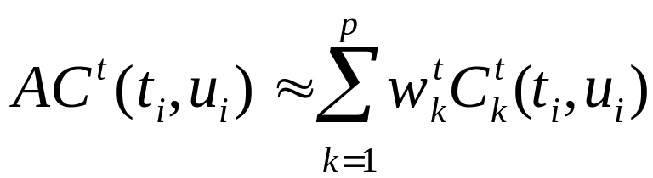
How to set target cost weights (4)
Target distance is
For examples in the database, we can measure
Therefore, estimate weights w from all examples of
Use linear regression
Richard Sproat slide

Slide 47
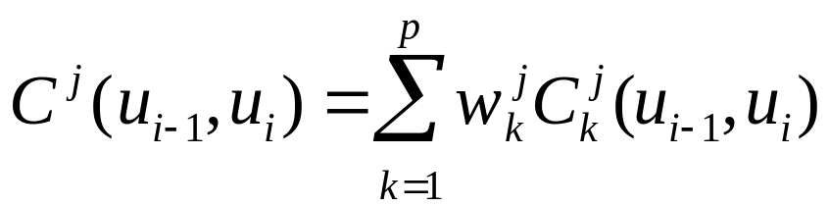
Join (Concatenation) Cost
Measure of smoothness of join
Measured between two database units (target is irrelevant)
Features, costs, and weights
Comprised of k subcosts:
  Spectral features
  F0
  Energy
Join cost:
Slide from Paul Taylor

Slide 48
Unit selection
The greatest difference between a Unit selection and a diphone voice is the length of the used speech segments.
There are entire words and phrases stored in the unit database. this implies that the database for the Unit selection voices are many times bigger than for diphone voices.
Thus, the memory consumption is huge while the CPU consumption is low.

Slide 49
Unit Selection
The most important issue is to still get a natural and smooth prosody.
This is hard because the units contain both intonation and pronunciation since entire phrases are used almost directly from the recorded data.
Since the first Unit selection voice was released, over eight years ago, there has been much improvement for each new voice with every release.

Slide 50
HMM synthesis
A quite new technology is speech synthesis based on HMM, a mathematical concept called Hidden Markov models.
It is a statistical method where the text-to-speech system is based on a model that is not known before hand but it is refined by continuous training.
The technique consumes large CPU resources but very little memory.
This approach seems to give a better prosody, without glitches, and still produces very natural sounding, human-like speech

Slide 51
HMM-based Speech Synthesis System (HTS)
Speech
Database
Speech Signals
Excitation Parameter Extraction
Spectral Parameter Extraction
Text
Analysis
Excitation Parameters
Spectral Parameters
Training Part
Contextual
Labels
HMM Parameter Estimation
Context Dependent HMMs & State Duration Models
Text
Analysis
Contextual
Labels
Parameter Generation from HMMs
Synthesis Part
Excitation Parameters
Spectral Parameters
Text
Excitation Generation
Excitation
MLSA Filter
Synthesized Speech

Slide 52
Automatic Speech Recognition (ASR)
ASR
  incoming acoustic waveform ->sequence of linguistic words
Speech is the most natural means of communication for humans and usually learned to a high degree of proficiency at a very early age.
ASR Applications:
  Natural human-machine communication
  Interactive problem solving
  Telecommunications
    Cost reduction (replace human operators)
    Revenue generation (new services)
  Hands-free operation
  Dictation & automatic transcription
  Aids for handicapped
  Automatic language translation

Slide 53
Speech Recognition
Modal
Generation
Input
Signal
Processing
Pattern
Matching
Output
Feature
Extraction
Training
Testing
Acoustic
Model
Matching
Symbol sequence
Language
Model
Matching
Sentence Hypothesis

Slide 54
The Speech Recognition Problem
If we know the signal patterns that represent every spoken word beforehand, we could try to identify the words whose patterns best match the input
  word patterns are never reproducible exactly
  How do we represent these signal patterns?
  Given this uncertainty, how do we compare the input to known patterns?
Speech recognition is the study of these problems

Slide 55
Why is Speech Recognition Difficult?
Tremendous range of variability in speech, even though the message may be constant:
  Human physiology: squeaky voice vs deep voice
  Speaking style: clear, spontaneous, slurred or sloppy
  Speaking rate: fast or slow speech→Speaking rate can change within a single sentence
  Emotional state: happy, sad, etc.
  Emphasis: stressed speech vs. unstressed speech
  Accents, dialects, foreign words
  Environmental or background noise
  Even the same person never speaks exactly the same way twice
In addition:
  Large vocabulary and infinite language
  Absence of word boundary markers in continuous speech
  Inherent ambiguities: “I scream” or “Ice cream”?

Slide 56
Technological Challenges
Representations of spoken words are inexact
  Even the same person never says a given sentence exactly the same way twice
  No representation can capture the infinite range of variations
  Yet, humans have apparently no difficulty
    They adapt to new situations effortlessly
  The problem is understanding and representing what is invariant
Pattern matching is necessarily inexact
  Given the above, there will always be mismatches in pattern matching, and hence misrecognitions
    Even humans are not perfect!
  Finding optimal pattern matching algorithms, and hence minimizing misrecognitions, is another challenge

Slide 57
As target vocabulary size increases, complexity increases
  Computational resource requirements increase
    Memory size to store patterns
    Computational cost of matching
  Most important, the degree of confusability between words increases
    More and more words begin sounding alike
    Requires finer and finer models (patterns)
    Further aggravates the computational cost problem

Slide 58
Trends in the Developments of ASR
Feature-Based Methods
Template-Matching Methods
Rule-Based Methods
Statistical Methods

Slide 59

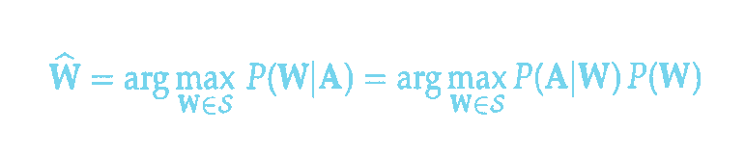
State-of-the-art: The Statistical Model
Communication Channel
Speaker
ASR System
Word Source
Speech Production
Acoustic Processor
Linguistic Decoder
W
A
ŵ
Language
Language
Speech
W : a string of words
A : acoustic signal observed by the recognizer
S : set of sentences that can be generated
P(A|W): the acoustic model P(W): the language model
Ref: Jelinek, 1991

Slide 60
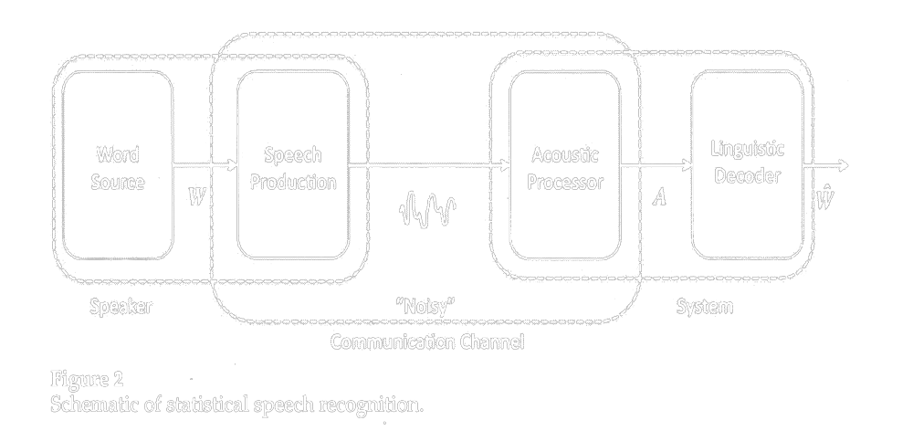
“Noisy” Communication Channel
Speaker
ASR System
Speech
Produc-
tion
Word
Source
Linguistic
Decoder
1. Is the speaker model true?
2. Is the noisy communication channel model valid?
3. Is the language model sufficiently accurate?

Slide 61
“Noisy” Communication Channel
ASR System
Speaker
1.
Word
Source
Speech
Produc-
tion
Acoustic
Processor
Linguistic
Decoder
W
︿
W
︿
Since W is the estimated output （string of words in the written
language), the input W must also be a message in the written
language. Hence this scheme shows a situation where the
speaker is given a text (by someone else) and reads it aloud.
© Hiroya Fujisaki

Slide 62
What does a speaker do?
The speaker’s functions are:
1. Understanding the input message W in the written language.
(Reading W aloud is possible only after understanding it.)
2. Generating the message S in the spoken language.

Slide 63
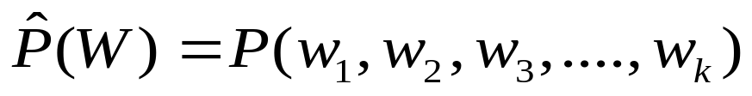
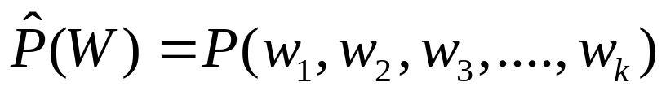
Is the language model sufficiently accurate?
Since a bigram (simple Markov) model is regarded insufficient for representing syntactic relationships between words, it has become a common practice to use trigram (second-order Markov) model as the language model. But trigram is still not good enough.
Simple Markov Model = Bigram Model
Simple Markov Model = Bigram Model
For a thousand word vocabulary, measurement of bigram probability
needs to examine occurrences of each of one million bigrams.
Second-order Markov Model = Trigram Model
For a thousand word vocabulary, measurement of trigram probability
needs to examine occurrences of each of one billion trigrams.
Since data is not enough, smoothing is introduced, but the validity is
not guaranteed. Still, trigram is a very poor model for syntax.

Slide 64
Limitations of the Statistical Approach
The statistical approach is limited since
It does not make distinction between the spoken language and the written language
The noisy communication channel model does not approximate the situation involving ambiguity
It is impossible to use higher-order statistics beyond word trigrams.

Slide 65
Spoken Language vs. Written Language
Conventional Concepts: Language vs. Speech
“Language” is the underlying code system common to
both speech and text.
“Speech” is the acoustic signal carrying the information
of the language.
New Concepts (Fujisaki, 1986）：
Spoken Language vs. Written Language
“Speech” and “Text” are physical signals but also serve
as different code systems. The information they carry
are not identical.
“Spoken Language” refers to both the signal and the
code system. The same applies to “Written Language.”
© Hiroya Fujisaki

Slide 66
Examples of Differences Between SL and WL as Code Systems
Difference in ambiguity:
Many expressions exist that are ambiguous in WL
but are unambiguous in SL, and vice versa; e.g.,
homonymity and homographism at the lexical level.
Homographism (ambiguous in WL but not in SL)
English: close, content, interest, increase, present,
record, recreation, wind, etc.
Homonymity (ambiguous in SL but not in WL)
English: flower/flour, knight/night, made/maid,
pray/prey, right/write, steal/steel, etc.
1.
© Hiroya Fujisaki

Slide 67
Examples of Differences Between SL and WL as Code Systems
2. Prosody in SLs allows disambiguation of some of
the ambiguities (e.g., lexical and syntactic) in WLs.
Example: syntactic ambiguity in WL
old men and women old men and women
All the young men went to war, leaving only old
men and women at home.
(b) Old men and women are called senior citizens.
1.
(a)
(b)
© Hiroya Fujisaki

Slide 68
Prosody in Spoken Languages allows disambiguation of some of the lexical and syntactic ambiguities in Written Languages.
Example: syntactic ambiguity in WL
(a)
(b)
পড়াশোনা কর না পড়লে শিখবে না
(unless you study, you can’t learn)
পড়াশোনা কর না পড়লে শিখবে না
(if you study, you can’t learn)

Slide 69
Examples of Differences Between SL and WL as Code Systems
1.
3. Difference in word boundary marking
In many (but not all) WLs, word boundaries are explicitly shown, but not in SLs, causing ambiguity
in SL.
English: I scream / ice cream [aiskri:m]
an ice cream / a nice cream
[ənaiskri:m]
night rate / niterate [naitreit]
© Hiroya Fujisaki

Slide 70
SL and WL are Different Code Systems
Certain kind/amount of linguistic information is
NOT shared by the Spoken Language (SL) and the Written Language (WL).
Hence they are two distinct systems for coding thelinguistic information.
Conversion of a message expressed in SL into a
message in WL (i.e., ASR) is only possible by
correctly inferring the information missing in the SL
message, and by expressing it in the WL message.
The same is true for conversion of a WL message
into an SL message.
1.
© Hiroya Fujisaki

Slide 71
Spoken word based or prosodic word based continuous speech recognition system.

Slide 72
Proposed Model
Hierarchy - I
DNN
Spoken lexical item detection
Speech Attribute detection
Manner based labeling
Acoustic Phonetic
Knowledge
Prosodic Information (f₀, Duration, Intensity
Pseudo word formation
Vowel Recognition
Lexical
Expert System
Unconstrained
Speech Signal
Final Decision
Hierarchy – II
Recognition output

Slide 73
Speech based Technology Development for e-Learning

Slide 74
Area of research
Computer Assisted Spoken Language Learning:
Objective: To Develop a Computer Assisted Spoken Language Learning tools with correct language pedagogy for faster accusation of second language speaking
Accent Conversion:
Objective: Transform the regional/foreign accent of a source speaker to have similar characteristics to that of another accent

Slide 75
Schematic diagram of the Computer Assisted Spoken Language Learning system
Test Speech of L2 Speaker
Expert Speaker Data base/ reference data base
Segmental Error Hypothesis model
Automatic Detection of Error
Feed back for Learning
Collected L2 Speaker data base
Supra-Segmental Error Hypothesis model

Slide 76





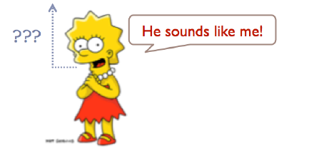

Very good lecture
L1 Japanese student
Source L1 Japanese speaking L2 English
L1 American student
Accent conversion
Speech spectacle

Slide 77
Walter Ong, 1982
Orality and Literacy: The Technologizing of the Word
Secondary
orality
163 years
Literacy
6000 years
Primary orality
200,000 years

Slide 78
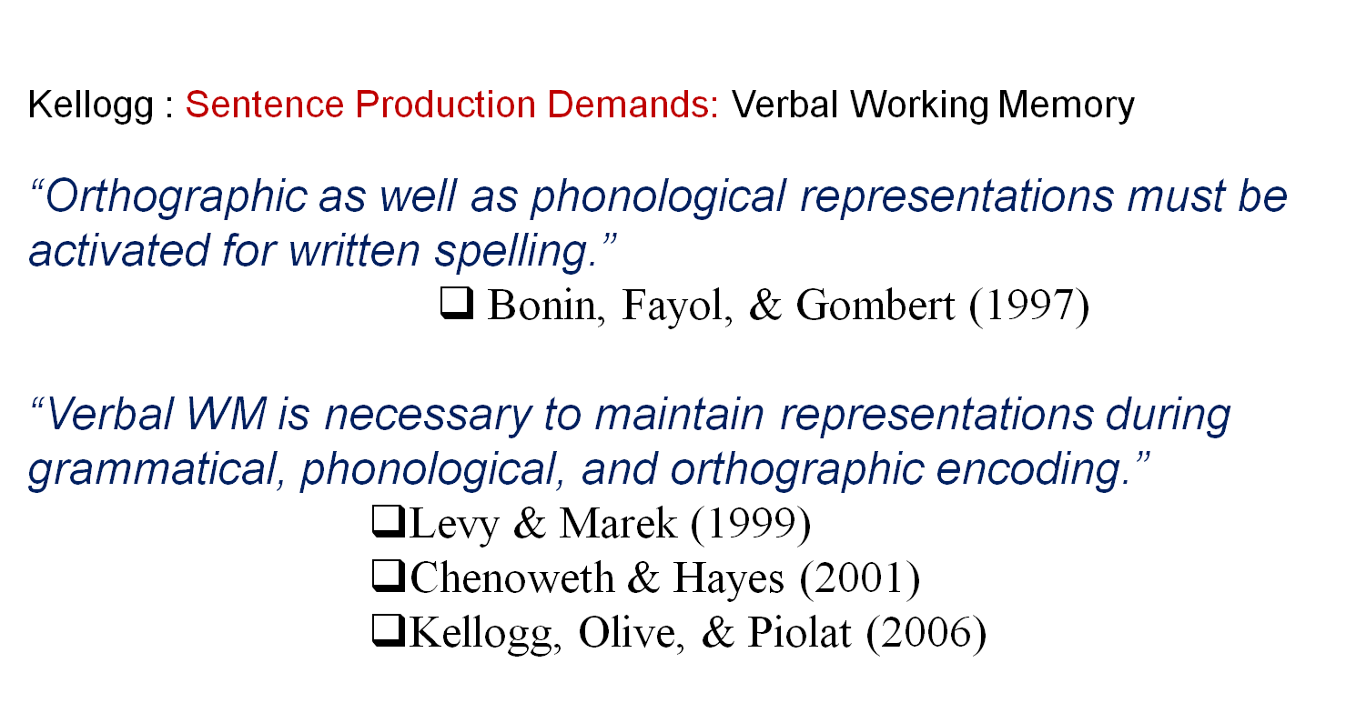
Orality and writing production
Kellogg, R. (2006) Training writing skills: A cognitive developmental perspective. EARLI SigWriting 2006 Antwerp.
http://webhost.ua.ac.be/sigwriting2006/Kellogg_SigWriting2006.pdf

Slide 79
Information manifestation in the segmental and suprasegmental features of speech
Input Information
Rule of Grammar
Rule of Prosody
Physiological Constraints
Physiological Constraints
Segmental and supra Segmental Features of speech
Linguistics
Lexical, Syntactic, Semantic,
Pragmatic
Massage Planning
Utterance Planning
Motor Command Generation
Speech Sound Production
Para- Linguistics
Intentional,
Attitudinal,
Stylistic
Non- Linguistics
Physical,
Emotional

Slide 80
Processes of Information Extraction from Speech
_{Physical}
_{Constraints}
_{Physiological}
_{Constraints}
_{Rules of}
_{Prosody}
_{Rules of}
_{Grammar}
_{Output Information}
_{Segmental and}
_{Suprasegmental}
_{Features of}
_{Speech}
_{Lexical}
_{Syntactic}
_{Semantic}
_{Pragmatic}
_{Speech}
_{Sound}
_{Analysis}
_{Motor}
_{Command}
_{Extraction}
_{Utterance}
_{Analysis}
_{Message}
_{Analysis}
_{Linguistic}
_{Intentional}
_{Attitudinal}
_{Stylistic}
_{Para-}
_{linguistic}
_{Physical}
_{Emotional}
_{Non-}
_{linguistic}

Slide 81
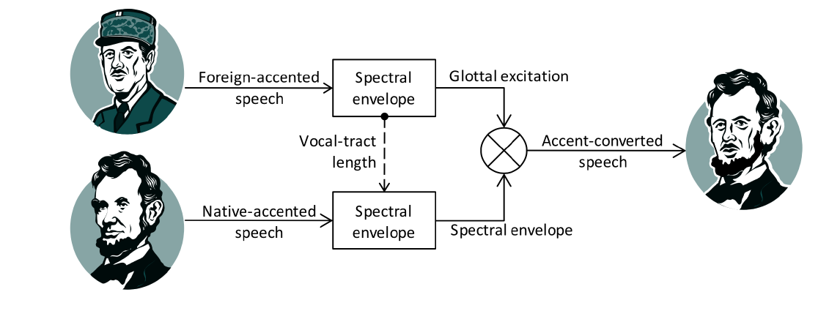
Accent conversion
Idea: Combine the spectral envelope of a native speaker with the excitation and vocal tract length of a non-native speaker

Slide 82
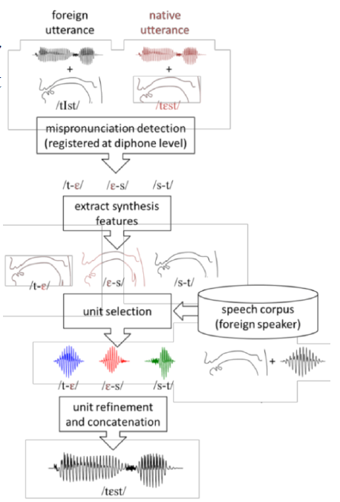
Research Trend
Foreign Accent Conversion Through Concatenative Synthesis in the Articulatory Domain
/træb^{h}lar/
t
r
æ
b^{h}
l
a
r
t
r
æ
b^{h}
e
l
a
r
Insertion

Slide 83
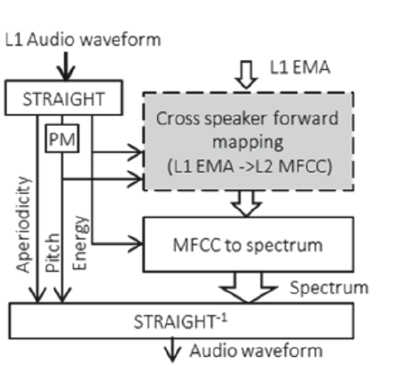
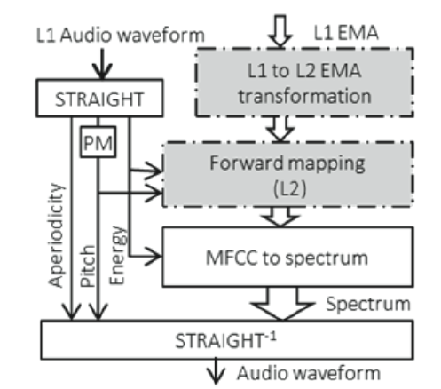
Accent Conversion through articulatory synthesis
Baseline articulatory accent conversion system
Articulatory accent conversion with a cross speaker forward mapping
Electromagnetic articulography (EMA)

Slide 84
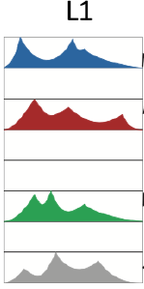




Source and target utterances are paired based on their wording in a forced aligned parallel corpus
L2

Slide 85


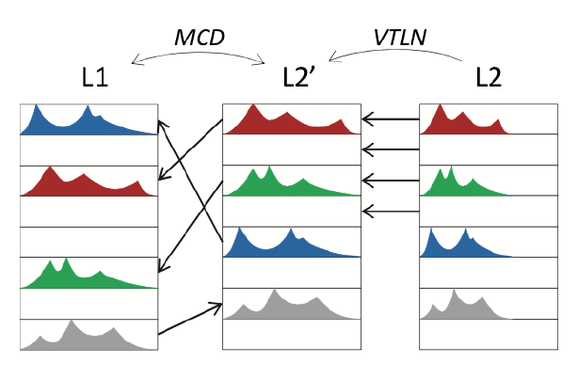
Accent Conversion through cross speaker articulatory synthesis
Step1. Apply VTLN to L2 acoustic vector y^{(L2)} to account for physiological differences of both speakers’ vocal tract.
Step2. For each vector y^{(L1)} we find its closet vector y^{(L2)} * to minimize Mel Cepstral distortion (MCD) between them as
repeat;
Step3. Discard pairs according to preselected threshold
Step4. Replace y^{(L1)} to x^{(L1)} , getting
look up table {x^{(L1)}, y^{(L2)} * }

Slide 86
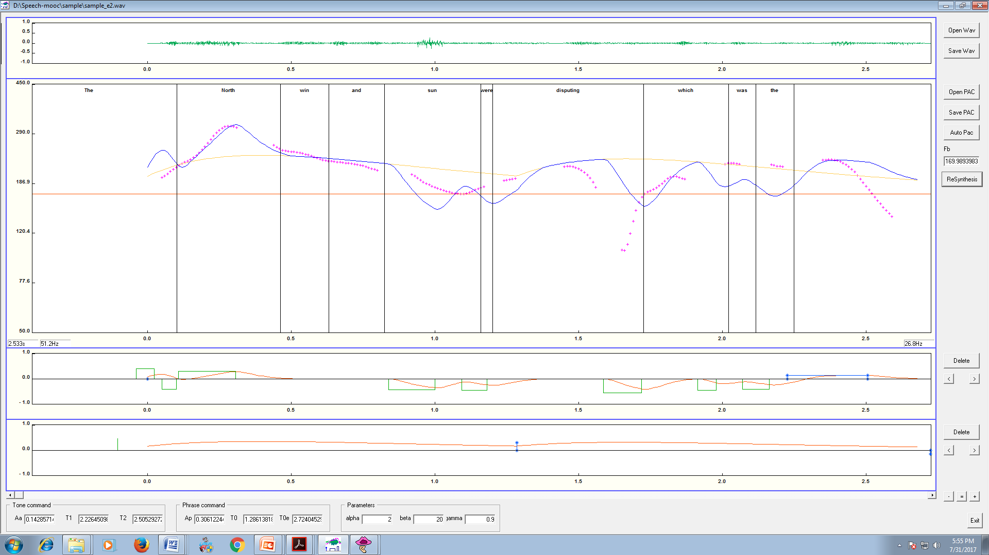
Original
Modified

